Slide 1
Employee Data Analysis using Excel
STUDENT NAME: ARCHANA A
REGISTER NO: 2213211036033
DEPARTMENT: COMMERCE
COLLEGE: PRESIDENCY COLLEGE CHENNAI-600005

Slide 2
PROJECT TITLE
Employee Performance Analysis using Excel

Slide 3


AGENDA
Problem Statement
Project Overview
End Users
Our Solution and Proposition
Dataset Description
Modelling Approach
Results and Discussion
Conclusion
3/21/2024 Annual Review

Slide 4

PROBLEM STATEMENT
The organization is experiencing high employee attrition and varying job satisfaction levels, impacting overall performance. There’s a need to analyze key factors such as job role, work-life balance, and leadership opportunities to understand their influence on retention and performance. The goal is to develop strategies to enhance employee satisfaction and reduce turnover.

Slide 5

PROJECT OVERVIEW
.
Analyze employee data to identify key factors affecting attrition, job satisfaction, and performance. The insights will help develop strategies to boost retention, enhance satisfaction, and improve overall performance.

Slide 6

WHO ARE THE END USERS?
HR Team: To develop targeted retention and employee engagement strategies.
Management: To make informed decisions on improving job satisfaction and performance.
Leadership: To identify opportunities for leadership development and succession planning.
Data Analysts: To provide ongoing insights and recommendations based on the data.

Slide 7

OUR SOLUTION AND ITS VALUE PROPOSITION
A data-driven analysis to uncover key factors affecting retention, satisfaction, and performance.
Value Proposition:
Reduce Turnover
Boost Job Satisfaction
Enhance Performance
Make Data-Driven Decisions

Slide 8
Dataset Description
Demographics: Age, Gender, and Employee ID.
Job Details: Job Role, Years at Company, Monthly Income, Job Level.
Work Conditions: Work-Life Balance, Remote Work, Company Size.
Performance Metrics: Job Satisfaction, Performance Rating, Promotions.
Attrition: Indicators of whether the employee stayed or left the company.

Slide 9

THE "WOW" IN OUR SOLUTION
Precision Targeting: Pinpoint exact factors driving attrition and low performance.
Actionable Insights: Turn data into clear, actionable strategies that make an immediate impact.
Tailored Interventions: Develop customized solutions that directly address unique organizational challenges. Predictive Power: Use data trends to anticipate future challenges and proactively improve employee experience
3/21/2024 Annual Review
9

Slide 10
MODELLING
Data Cleaning & Preprocessing: Standardize formats (e.g., dates, salaries).Handle missing values and outliers to ensure data quality.
Exploratory Data Analysis (EDA):Visualize salary distribution across departments, genders, and locations. Identify trends, anomalies, and disparities.
Segmentation: Group employees based on factors like department, role, and experience to understand salary patterns.
Predictive Modeling: Use regression models to predict fair salary ranges based on factors like experience, role, and market data.
10

Slide 11
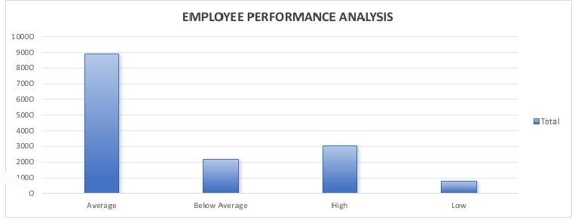
RESULTS
11

Slide 12
conclusion
Our performance analysis has highlighted key disparities and provided actionable insights for creating a more equitable and competitive compensation structure. By implementing the recommended adjustments, the company can enhance employee satisfaction, improve retention, and align salaries with industry standards, ultimately supporting sustainable growth and a fair workplace.

